Slide 1
SQL Workshop
An Introduction to and Basic Applicaton of SQL

Slide 2
Agenda
Vocabulary
Relational Databases
Select Statements
Select Statement Practice

Slide 3
The Basics

Slide 4
Data….Its a Big Deal
Poor data quality leads to poor decision making
Difficult customer communication
Inventory shortages
Metrics vs KPIs
S.M.A.R.T
Cost-benefit tradeoff to achieve desired level of data quality
Long-term effects of poor data quality
Notes:
“Garbage in = Garbage out”….discuss effects of cascade update/delete on databases
Specific
Measurable
Achievable
Realistic
Timely

Slide 5
Vocabulary
MySQL: Standard Query Language
Query: request for data to answer a question
Data: raw facts/statistics about things and events
Information: transformed data that has value for decision making
Knowledge: refers to a deterministic process where patterns within a given set of information are ascertained
Data → Information → Knowledge → Decisions
Notes:
Why SQL?
-Language for database definition, manipulation, and control
-International standard
- Write and execute statements using a specialized editor (standalone)
- Embed statements into a procedural language (embedded)
-Intergalactic database speak
It is named after co-founder Michael Widenius' daughter, My. The SQL phrase stands for Structured Query Language.

Slide 6
Vocabulary…Part 2
SELECT statement
Query statement
INSERT statement
Relational Database
Entity Integrity
Referential Integrity
Primary Keys
Foreign Keys
Notes:
Entity integrity: primary keys
Each table has column(s) with unique values
No two rows with the same primary key
No null values in any party of the primary key --- NO DUPLICATE DATA
Referential integrity: foreign keys --- parent and child tables
Values of a column in one table match values in a source table
Ensures valid references among tables
Foreign keys reference a table’s primary key --- They represent relationships

Slide 7
Relational Databases

Slide 8
What is a Table?
Rows
These are the records you are storing in the database
Specific data stored
Columns
These are the identifiers of the rows
PK, FK, and others
If a row has a value in a PK column, it must be unique!
Notes:
Every table has these and this where your PK resides
Many other rows exist that are not PK
Some may be FK rows
Some may be rows that have dupes and cannot be PK
These attributes or data fields that fill the table
These are the specific data values you think of when you see a table

Slide 9
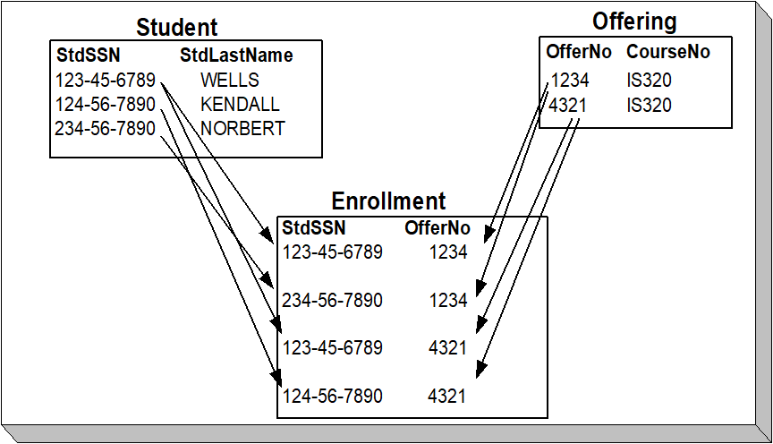
Relational Database: How It Works
Notes:
Student Table (PK = StdSSN), Offering Table (PK=OfferNo) → these tables are made first
Enrollment Table(FK = StdSSN, OfferNo) – What is its PK? (compound PK of both FK)
---this table is a weak entity: it cannot exist on its own
Why is this important? Select statements are often dependent on understanding PK and FK relationships

Slide 10
Select Statements

Slide 11
Select Statement
SELECT <list of column expressions>
FROM <list of tables and join operations>
WHERE <list of logical expressions for rows>
GROUP BY <list of grouping columns>
HAVING <list of logical expressions for groups>
ORDER BY <list of sorting specifications>
Notes:
Select grabs desired column(s)
-discuss usage of AS (creates alias column – not actual column but will see in output)
From describes the tables you are accessing
Where a=b, a>b, a<b
Group By: maybe I want to group by a date, year, semester
Having: specific characteristics that you want of the group --- use aggregrate summarizing values like ( AVG(GPA) > 3.1) ---don’t use if you are not using aggregate functions
Order by: sorting specifications like ascending, descending, alphabetical etc

Slide 12
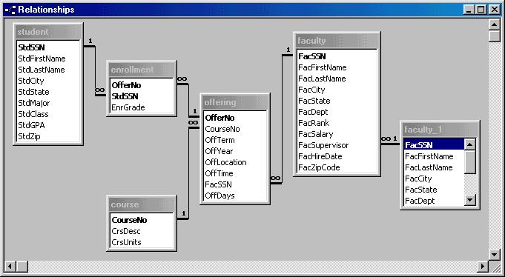
University Database

Slide 13
Select Examples
SELECT *
FROM Faculty
SELECT *
FROM Faculty
WHERE FacSSN = '543210987'
SELECT FacFirstName, FacLastName, FacSalary
FROM Faculty
SELECT FacFirstName, FacLastName, FacSalary
FROM Faculty
WHERE FacSalary > 65000
AND FacRank = 'PROF'
Notes:
Example 1:
- Retrieves all rows and columns
- * in the SELECT clause evaluates to all columns of the FROM tables
Example 2:
- Retrieves a single faculty row (subset of rows)
- Relational algebra: restrict operation (row subset)
- Oracle: use hyphens in FacSSN constant (543-21-0987)
Example 3:
- Retrieves a subset of columns
- Relational algebra: subset of columns
Example 4:
- Retrieves a subset of rows and columns
- Sequence of restrict and project operations

Slide 14
Inexact Matching
Match against a pattern : LIKE operator
Use meta characters to specific patterns
Wildcard (* or %)
Any single character (? or _)
Example
SELECT *
FROM Offering
WHERE
CourseNo LIKE ‘MATH%'
Notes:
Common patterns:
- Strings with specified endings
- Strings with specified beginnings
- Strings containing a substring
Meta characters:
- Special meaning when using the LIKE operator
- Many others available: study DBMS documentation
Example 6:
- Retrieves offerings of MATH course numbers
_ is for MySQL

Slide 15
Select Statements
Joins

Slide 16
Join Operator
Combining tables based up a specific characteristic
Most common is PK=FK
Can also use <, >, !=
Types of Joins
Inner
Outer
Left, Right, Full

Slide 17
Full Outer Join
Customer
Order
Left Outer Join
Right Outer Join
Inner Join
Unmatched rows of the left table
Matched rows using the join condition
Unmatched rows of the right table
Notes:
Outer join matching:
- The INNER JOIN keyword selects records that have matching values in both tables. (AND)
If there are records in the "Orders" table that do not have matches in "Customers", these orders will not be shown!
- One-sided outer join: preserving non matching rows of a designated table (left or right)
The LEFT JOIN keyword returns all records from the left table (Customers), even if there are no matches in the right table (Orders).
- Full outer join: FULL OUTER JOIN keyword return all records when there is a match in either left (table1) or right (table2) table records. (OR)
If there are rows in "Customers" that do not have matches in "Orders", or if there are rows in "Orders" that do not have matches in "Customers", those rows will be listed as well.

Slide 18
University Database

Slide 19
Join Example
SELECT OfferNo, CourseNo,
FacFirstName, FacLastName
FROM Offering INNER JOIN Faculty
ON Faculty.FacSSN = Offering.FacSSN
WHERE OffTerm = 'FALL' AND OffYear = 2002
AND FacRank = 'ASST' AND CourseNo LIKE ‘IS%’;
Notes:
Notice the dot operator with Faculty.FacSSN and Offerring.FacSSN
-this allows us to distinguish which table FacSSN is coming from
-without this we could not join the tables – ambiguity!
---this forces the database to determine where the queries go not the user: BAD

Slide 20
Select Statements
Summarizing Tables

Slide 21
Summarizing Tables
Row summaries important for decision-making tasks
Row summary
Result contains statistical (aggregate) functions
Conditions involve statistical functions
SQL keywords
Aggregate functions in the output list
GROUP BY: summary columns
HAVING: summary conditions
Notes:
Row summary: compress multiple rows into a single row
Row details are important for operational decision-making (resolving a customer complaint, finding lost shipment, …)
Row summaries are important for tactical and strategic decision-making (remove details)
Problem involves row summaries:
- Result contains aggregate functions: count of students enrolled, average salary, sum of
the credit hours
- Conditions involve aggregate functions: number of students enrolled less than 10
SQL features for summarizing tables:
- SQL2 has limited features
- Aggregate functions in output list
- Standard aggregate functions (COUNT, MIN, MAX, SUM, AVG)
- Most DBMSs have many other functions available
- GROUP BY columns: indicate columns to summarize on
- HAVING (optional): indicate group conditions

Slide 22
GROUP BY Examples
SELECT FacRank, AVG(FacSalary) AS AvgSalary
FROM Faculty
GROUP BY FacRank
SELECT StdMajor, AVG(StdGPA) AS AvgGpa
FROM Student
WHERE StdClass IN ('JR', 'SR')
GROUP BY StdMajor
HAVING AVG(StdGPA) > 3.1
Notes:
Example 12:
- Row summary because output uses AVG function
- Rename output column when using aggregate expressions
- Retrieves a one row per faculty rank (ASST, ASSC, PROF)
---gives me average salary of faculty rank
Example 13:
- Summarize majors of upperclass students by average gpa; only include majors
with avggpa > 3.1
- Row condition: cannot use aggregate function
***WHERE cannot have aggregate function because it is using a row condition of the table that doesn’t exist if you use an aggregate function
- Group condition: uses aggregate functions
- Do not use a condition in HAVING unless the condition involves an aggregate function

Slide 23
SQL Summarization Rules
Columns in SELECT and GROUP BY
SELECT: non aggregate and aggregate columns
GROUP BY: list all non aggregate columns
WHERE versus HAVING
Row conditions in WHERE
Group conditions in HAVING
Notes:
Columns in SELECT and GROUP BY:
- Syntactic rule: syntax error if you do not follow
- All columns not part of aggregate function must appear in GROUP BY of SELECT
- Applicable to some difficult problems involving joins and grouping
WHERE vs. HAVING:
- WHERE conditions: cannot have aggregate functions (syntax error)
select * from Student Where stdgrp>2.0
- HAVING: only use conditions that involve an aggregate function
select FacCity, FacSalary From Faculty Having avg(salary) > 100
- Query executes more slowly if HAVING includes row conditions

